Slide 1
https://www.chabad.org/4800799

Slide 2
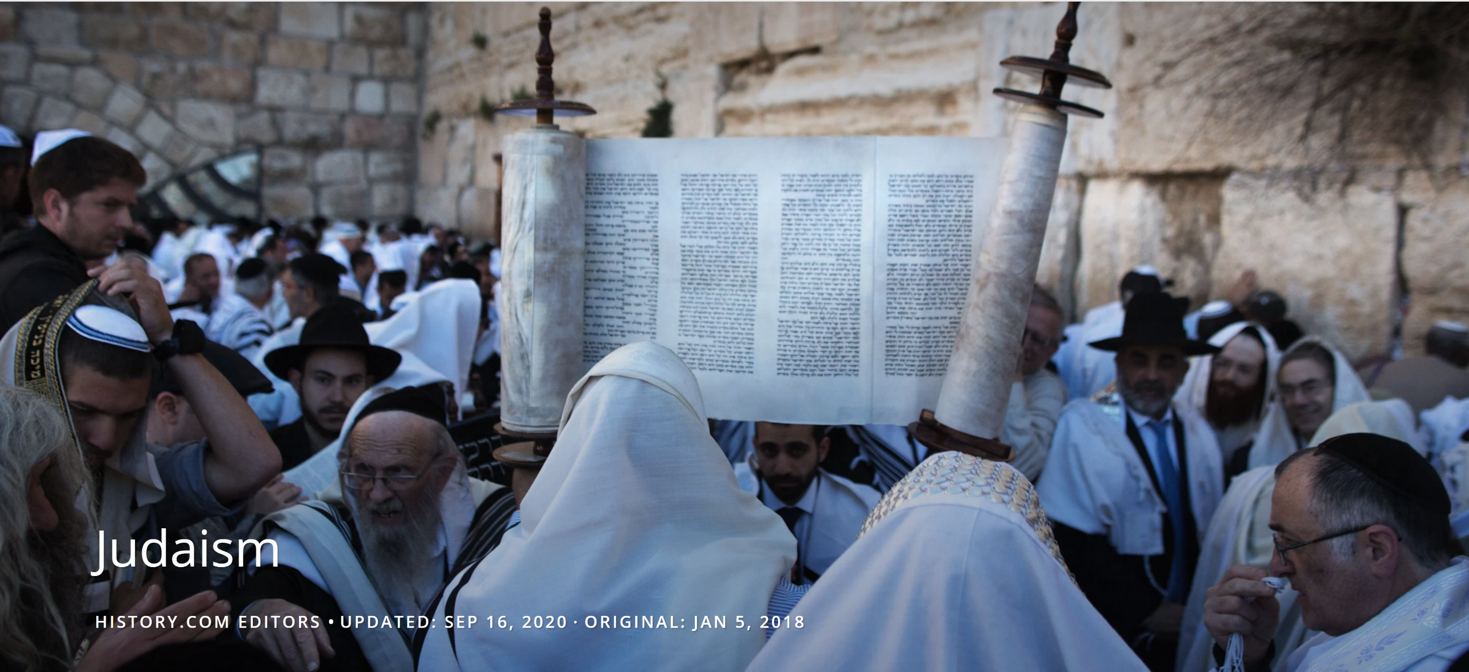
Judaism is the world’s oldest monotheistic religion, dating back nearly 4,000 years. Followers of Judaism believe in one G-d who revealed himself through ancient prophets. The history of Judaism is essential to understanding the Jewish faith, which has a rich heritage of law, culture and tradition.

Slide 3
Founder of Judaism
The origins of Jewish faith are explained throughout the Torah. According to the text, God first revealed himself to a Hebrew man named Abram, who later became known as Abraham (father of many nations-Gen. 14:13, 17:5) and the founder of Judaism.
Jews believe that God made a special covenant with Abraham and that he and his descendants were chosen people who would create a great nation.
Abraham’s son Isaac, and his grandson Jacob, also became central figures in ancient Jewish history. Jacob took the name Israel, and his children and future generations became known as Israelites.
More than 1,000 years after Abraham, the prophet Moses led the Israelites out of Egypt after being enslaved for hundreds of years.
According to scriptures, God revealed his laws, known as the Ten Commandments, to Moses at Mt. Sinai.

Slide 4
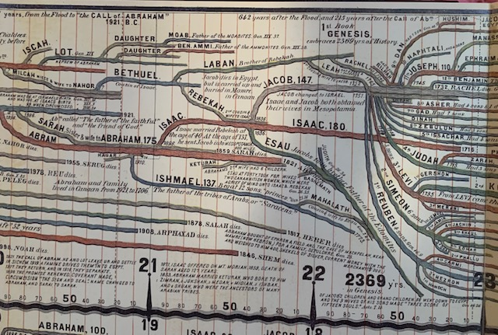

Slide 5
Judaism Beliefs
Jewish people believe there’s only one G-d who has established a covenant—or special agreement—with them. Their G-d communicates to believers through prophets and rewards good deeds while also punishing evil.
Most Jews (with the exception of a few groups) believe that their Messiah hasn’t yet come—but will one day. (Christianity believes the Messiah has already come).
Jewish people worship in holy places known as synagogues, and their spiritual leaders are called rabbis. (Christianity worship in places called churches)
The six-pointed Star of David is the symbol of Judaism. (Christianity’s symbol is the cross)
Today, there are about 14 million Jews worldwide. Most of them live in the United States and Israel.
Traditionally, a person is considered Jewish if his or her mother is Jewish.

Slide 6
Basic Jewish Beliefs
The Jewish people believe by definition that G‑d is the single creator and animator of the world. He has no helpers, no children and no rivals. (Christianity believes God has a Son and his name is Jesus) and that the God head is made up of the Father, Son and the Holy Spirit) John 1:1.
G‑d is everywhere and has no properties (for that matter, G‑d granted humanity the gift of free choice neither is He really a “he.”) In Jewish belief, G‑d is the invisible force behind everything that happens and knows everything, past present and future. (And the Word was made flesh, and dwelt among us, (and we beheld his glory, the glory as of the only begotten of the Father,) full of grace and truth (John 1:14).
G‑d granted humanity the gift of free choice. When people follow His ways (as outlined in the Torah), G‑d rewards them. These rewards can be in this world, as well as in the World to Come, which comes after death.
Just as every individual works hard toward achieving personal perfection through following G‑d’s ways, so is the entire world heading toward a time of eternal peace and plenty. For by grace are you saved through faith; and that not of yourselves: it is the gift of God: not of works, lest any man should boast (Ephesians 2:8).
This time is known as the era of Moshiach (or Messiah). (Christianity refers to this as the Millennium Kingdom; Blessed and holy is he that has part in the first resurrection: on such the second death has no power, but they shall be priests of God and of Christ, and shall reign with him a thousand years (Rev. 20:6).
During this time, Jews will return to the Land of Israel and rebuild the Holy Temple in Jerusalem (see below). A most amazing feature of this time is that death will cease, and the dead will be brought back to life.

Slide 7
QUESTIONS
QUESTIONS
COMMENTS

Slide 8
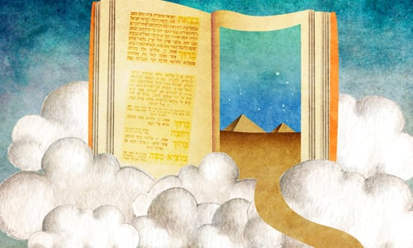
The Story of Judaism

Slide 9
The story of the Jewish people begins with G‑d creating the world in six days and resting on the seventh. Then, He chose Abraham and his children to become His special nation who would dwell in a special homeland (Israel).
After a 210-year stint of slavery in Egypt, G‑d took His people to Mount Sinai, where he made a covenant with them and gave them instructions for life.
After 40 years of wandering, the Israelites entered the Promised Land. In time, they built a Holy Temple (Beit Hamikdash) in Jerusalem, where they could offer sacrifices and connect to G‑d.
The Holy Temple was eventually destroyed by Roman invaders, and the Jewish people went into exile and were scattered all over the world (galut).
But the story is not over yet. We believe that the time will come when we will once again be gathered in our homeland with a rebuilt Temple in a world that will be peaceful, G‑dly and perfect.

Slide 10
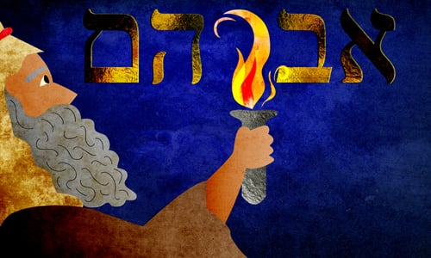
There are three names for the descendants of Abraham:
The Torah refers to Abraham as a Hebrew (Gen. 14:13), and that name is most commonly associated with the language of his descendants.
His grandson, Jacob, was given a second name of Israel, and that name has become closely associated with Israelite homeland.
Of, Jacob’s 12 sons, Judah had the role of leadership. At one point, he was the dominant tribe among those living in Israel, and the entire nation became known as Jews, and their creed, Judaism.
Where Does the Term Judaism Come From?

Slide 11
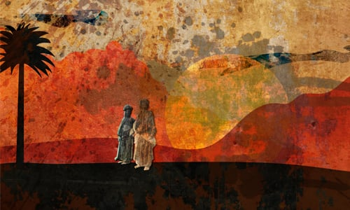
Who Are the Hebrews?

Slide 12
The first person to be called a Hebrew was Abraham (Gen. 14;13), and the name commonly refers to his descendants, known as the Jewish people. The word for Hebrew used in the Bible is עברי (pronounced "Ivri"), meaning "of or pertaining to עבר-ever."
The Midrash 2 quotes three opinions as to where this name comes from:
Rabbi Yehuda taught that the word "ever" means "opposite side." Abraham believed in one G‑d, and the rest of the world worshipped man-made gods.
Rabbi Nechemiah opined that it is a reference to Ever, great-great-grandson of Noah, Eber was one of the bearers of the monotheistic tradition which he had learned from his ancestors Shem and Noah and passed on to his grandson Abraham. Since Abraham was a descendant and disciple of his, he is called an Ivri.
The rabbis held that the word is a reference to the fact that Abraham came from the other side of the river and was not a native Canaanite. "Ivri" also refers to the fact that Abraham spoke the Hebrew language—thus named because of its ancient origins, preceding the development of the other languages current at that time.
So, Hebrew means the one who is opposed, on the other side, and different from all others. Abraham was a solitary believer in a sea of idolatry.
Who are the Hebrews today?
The Jewish people, who after 3,000 years still cling to their peculiar beliefs and are not swayed by the passing fancies of pop culture, are the same contrary people as their ancestors—the Hebrews of old.

Slide 13
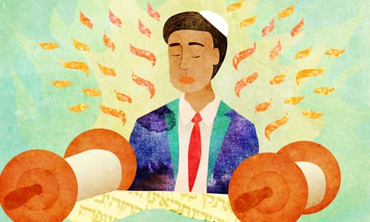
Moses—the leader who led the Jews out of Egypt and to whom G‑d communicated in the presence of the people at Mount Sinai—recorded the story of creation and the history of Abraham’s family up until his time in what became known as the Torah, or the Five Books of Moses. In addition, the Torah also contains G‑d’s instructions for personal and communal life.
The Torah –
Sacred Texts
of Judaism

Slide 14
Torah
The Jewish sacred text is called the Tanakh or the “Hebrew Bible.” It includes the same books as the Old Testament in the Christian Bible, but they’re placed in a slightly different order. The Torah—the first five books of the Tanakh—outlines laws for Jews to follow. It’s sometimes also referred to as the Pentateuch.
While the Tanakh (which includes the Torah) is considered the sacred text of Judaism, many other important manuscripts were composed in later years. These offered insights into how the Tanakh should be interpreted and documented oral laws that were previously not written down.
Around 200 A.D., scholars compiled the Mishnah—a text that describes and explains the Jewish code of law that was previously orally communicated.
Talmud
Later, the Talmud, a collection of teachings and commentaries on Jewish law, was created. The Talmud contains the Mishnah and another text known as the Gemara (which examines the Mishnah). It includes the interpretations of thousands of rabbis and outlines the importance of 613 commandments of Jewish law.
The first version of the Talmud was finalized around the 3rd century A.D. The second form was completed during the 5th century A.D.
Judaism embraces several other written texts and commentaries. One example is the 13 Articles of Faith, which was written by a Jewish philosopher named Maimonides.

Slide 15
Prophets and Writings: In addition to the Torah, there are 19 other books that are sacred to the Jewish people. They are grouped into Neviim and Ketuvim, (Prophets and Writings). They contain the history of the Jewish people for several hundred years from after Moses’ death, as well as prophetic communications from great leaders of the Jewish people.
Oral Torah: Alongside the Divine traditions that Moses recorded in the Torah, there were many details and commandments from G‑d that were communicated and preserved orally. As time went on, the sages of each generation discussed the Torah and elaborated on its principles. These discussions were eventually written down, becoming the Mishnah, Talmud and Midrash.
These texts are still being studied, explored and expanded on as we speak. In addition to individual scholars and study groups, there are academies (yeshivahs) where people study these traditions. In many places, Jewish children attend private schools where they can learn Torah in addition to their secular education. Some children may attend Hebrew school, where they learn about Judaism outside of their regular school hours. Since 1994, Torah study has been accessible online through Chabad.org and other sites.
According to scriptures, God revealed his laws, known as the Ten Commandments, to Moses at Mt. Sinai.

Slide 16
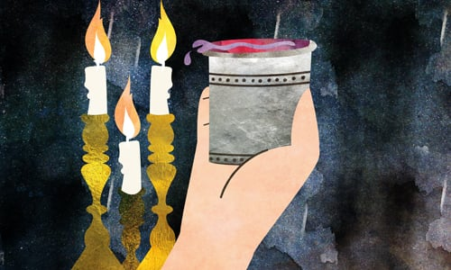
The Torah contains 613 instructions, called mitzvahs.
While some of these mitzvahs pertain to the Holy Temple, others are applicable to day-to-day Jewish life. Here are some of the basics.
Jewish Practices

Slide 17
Shabbat: Remember that G‑d created the world in six days and rested on the seventh? He commanded His people to do the same. Every seventh day (Friday night to Saturday night) Jewish people feast, pray and enjoy a break from everyday life. The Shabbat is ushered in with candlelighting late on Friday afternoon.
Holidays: There are numerous Jewish holidays. You can read more about them below.
Kosher (dietary): In the Torah G‑d sets forth a special diet for His people. Only certain species of animal may be eaten (no pork of shellfish), meat must be slaughtered in a special way, and meat and dairy are kept completely separate.
Prayer: Jews pray regularly to G‑d, often communally in a synagogue. The backbone of the prayer service is a line from the Torah called the Shema, which reads: Shema Yisrael A-donai E-lohainu A-donai Ekhad. In addition to being said every morning and night, this prayer is also said as a Jew prepares to pass on to the next world.
Tallit and Tefillin: Jewish males are enjoined to wear certain “adornments,” which are most often donned during prayer. The tefillin are leather boxes that are strapped to the head and arm. They contain sacred scrolls, which contains snippets of the Torah, including the Shema.
The tallit is a four-cornered garment (often white with black stripes) worn draped over the shoulders. When we look at the fringes (tzitzit) on each corner, we are reminded of G‑d and His commandments.
Mezuzah: Mezuzahs are placed in the upper right-hand side of doorways in Jewish homes. The mezuzah case contains a scroll with the Shema written on it.

Slide 18
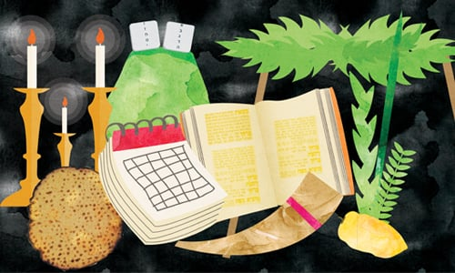
Jewish Holidays

Slide 19
In the fall there are the high holidays: Rosh Hashanah (the New Year), which is celebrated with prayers, hearing the blasts of the shofar (ram’s horn) and feasts, which include the traditional dish of apples dipped in honey;
Yom Kippur (Day of Atonement), when Jews gather to pray and don’t eat or drink for 25 hours;
Sukkot, celebrated by dwelling in special huts called sukkahs, and taking the four kinds.
These are followed by Chanukah, in the winter, which is celebrated with lighting a candelabra called a menorah (or chanukiah) for eight consecutive nights,
Purim, which is a joyful holiday toward the end of winter.
In the spring, Jews celebrate Pesach (or Passover), during which we get rid of all leaven (dough that has risen). Instead, matzah (a flat cracker-like food) is eaten.
This is followed by Shavuot, which marks the day of the Divine revelation at Sinai, when we received the Torah.

Slide 20
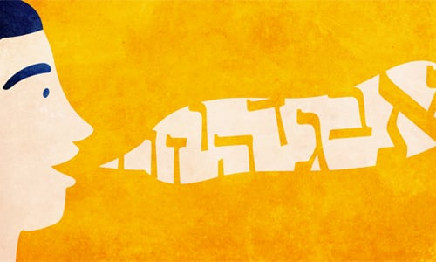
The Torah and most of the Writings and Prophets are in Hebrew, the language that G‑d used to create the world. In time, Jews began to speak Aramaic, and that became the language of the Talmud.
As Jews migrated to Europe, they began to speak special dialects of Spanish and German. Those became known as Ladino and Yiddish, respectively. There are also Jewish dialects of Arabic.
The Language of Judaism

Slide 21
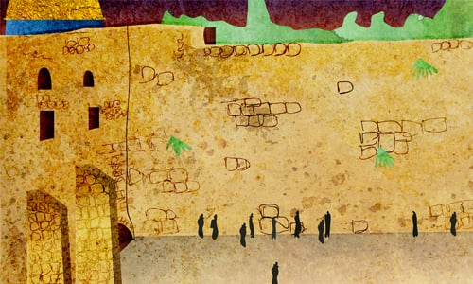
The Land of Israel is the sacred birthright of the Jewish people. The holiest city is Jerusalem, which is the place G‑d chose for His presence to dwell in (2 Samuel 15:29, 1 Kings 11:36, 15:4). The holiest place in Jerusalem is the Temple Mount, where the two Holy Temples stood. Since Jews can no longer go there, the Western Wall, which hugs the western embankment of the mountain, has become the central place for Jewish prayer. It is also known as the Kotel (“wall”).
All over the world, Jews gather regularly to pray in synagogues (also called shuls). In the front of the synagogue (in the direction that faces Jerusalem), is the Holy Ark, a cabinet in which the Torah scrolls (each one handwritten on parchment) are housed.
Around 1000 B.C., King David ruled the Jewish people. His son Solomon built the first holy Temple in Jerusalem, which became the central place of worship for Jews. The kingdom fell apart around 931 B.C., and the Jewish people split into two groups: Israel in the North and Judah in the South.
Sometime around 587 B.C., the Babylonians destroyed the first Temple and sent many Jews into exile. A second Temple was built in about 516 B.C. but was eventually destroyed by the Romans in 70 A.D. The destruction of the second Temple was significant because Jewish people no longer had a primary place to gather, so they shifted their focus to worshipping in local synagogues.
But Jewish worship can happen anywhere, and every place can become a holy place. Do something nice and make G‑d proud somewhere, and you’ve made that place a sacred spot.

Slide 22
Judaism is the automatic religion of every Jew. And a Jew is someone who was either born to a Jewish mother or converted to Judaism with a bonafide rabbinical court. There are some Jews who (for whatever reason) have Jewish worship can happen anywhere lapsed in their practice of Judaism. Some may profess to believe in another religion or have no beliefs at all. They are still Jewish, and the Torah and its teachings remain their eternal birthright.
Non-Jews are not bound by most of the Torah. They are, however, enjoined to live in accordance with the Seven Noahide Laws, which set the groundwork for a moral and just society.
Who Is Judaism For, and Is Judaism a Religion?

Slide 23
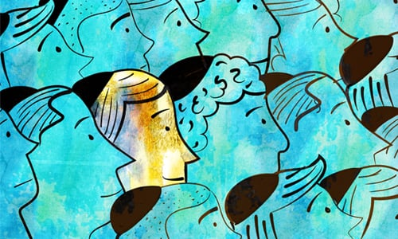
Are There Different Kinds of Jews?
Every Jew has equal access to G‑d. The more mitzvahs you do, the more Torah you study, and the more you work on refining your character, the closer you come to G‑d. No individuals or organizations hold the keys to heaven.
In ancient times, there were twelve tribes of Israel, each one of whom had a different territory in the land. The tribe of Levi was selected to be G‑d’s servants. They taught Torah to the people and cared for the Holy Temple. Within Levi, there were the kohanim (priests), who offered sacrifices in the Temple.
Today, most Jews do not know which tribe they are from. However, the exception is the Levites and Kohanim, many of whom have preserved their tribal identity.
Rabbis are learned Jews, who are proficient in key areas of the Torah. Like a doctor is qualified to give medical advice and prescribe medicine, someone who has been conferred the title “rabbi” can be relied upon to be a trustworthy and accurate conduit of Jewish tradition, belief and practice.

Slide 24
Types of Judaism
There are several sects in Judaism, which include:
Orthodox Judaism: Orthodox Jews are typically known for their strict observance of traditional Jewish law and rituals. For instance, most believe Shabbat shouldn’t involve working, driving or handling money.
Orthodox Judaism is a diverse sect that includes several subgroups, including Hasidic Jews. This form started in the 18th century in Eastern Europe and holds different values than traditional or ultra-Orthodox Judaism. Hasidic Jews emphasize a mystical experience with God that involves direct communion through prayer and worship. Chabad is a well-known Orthodox Jewish, Hasidic movement.
Reform Judaism: Reform Judaism is considered a liberal category of the religion that values ethical traditions over strict observance of Jewish laws. Followers promote progressive ideas and adaptation. Most of the Jews living in the United States follow Reform Judaic traditions.
Conservative Judaism: Many people consider this form of Judaism somewhere in between Orthodox and Reform Judaism. Typically, conservative Jews honor the traditions of Judaism while allowing for some modernization.
Reconstructionist Judaism: Reconstructionism dates back to 1922 when Mordecai Kaplan founded the Society for the Advancement of Judaism. This sect believes that Judaism is a religious civilization that’s constantly evolving.
Humanistic Judaism: Rabbi Sherwin Wine founded this denomination of Judaism in 1963. Humanistic Jews celebrate Jewish history and culture without an emphasis on God.
While there are various denominations of Judaism, many Jews don’t identify with a particular classification and simply refer to themselves as Jewish.

Slide 25
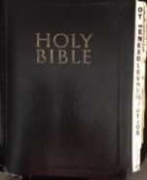
Woe to you, scribes and Pharisees, hypocrites! for you compass sea and land to make one proselyte, and when he is made, you make him twofold more the child of hell than yourselves (Matthew 23:15). All therefore whatsoever they bid you observe, that observe and do; but do you not after their works: for they say, and do not. For they bind heavy burdens and grievous to be borne, and lay them on men's shoulders; but they themselves will not move them with one of their fingers (Matthew 23:3-4). Thus have you made the commandment of God of none effect by your tradition (Matthew 15:6b).

Slide 26
BEWHOLE UNIVERSITY-2021
Dates: January 09, 2022 @ 9:30am
Teacher, Prophetess Clark
Email: bwccuniversity@gmail.com
“Where becoming and being whole is our passion”
Class sign out is,
Judaism

