Slide 1
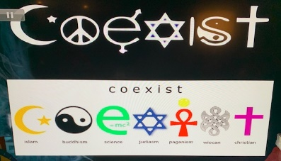

Slide 2
https://youtu.be/jbeFQtaybB8

Slide 4
Then departed Barnabas to Tarsus, for to seek Saul: And when he had found him, he brought him to Antioch. And it came to pass, that a whole year they assembled themselves with the church, and taught much
people. And the disciples were called
Christians (Christ like) first in Antioch
(Acts 11:25-26).

Slide 5
https://youtu.be/Ut-UOhY0s8E

Slide 6
5 TRUTHS EVERY CHRISTIAN BELIEVES
THE BIBLE IS GOD’S WORD
GOD IS THREE IN ONE
JESUS IS FULLY GOD
WE ARE SAVED BY FAITH
THERE’S LIFE AFTER DEATH:

Slide 7
THE BIBLE IS GOD’S WORD
All scripture is given by inspiration of God, and is profitable for doctrine, for reproof, for correction, for instruction in righteousness (2 Timothy 3:16).

Slide 8
By definition Christianity could be defined as belief in:
Monotheism, belief in one God
Father
That this one God had a Son name Jesus the Christ.
Jesus
saith to him, I am the way, the truth, and the life: no man comes to the Father, but by me (John 14:6).
Holy Spirit
Became human, was conceived by the Holy Ghost, born of the Virgin Mary, suffered, crucified, died, was buried, descended into hell, raised from the dead on the third day, ascended into heaven and is now seated on the right hand of God the Father and will one day return for his people.
God as three in one is the essence and expression of three individuals expressed as one called the Trinity.
He being the substitute for us; dying in our place, for all sinners have fallen short of God’s glory.
Then we that believe his testimony have now been filled with his Holy Spirit are now his witnesses as we share the story of his gospel (the good news) that we can be forgiven, by a new and living way, which he has consecrated for us, through the veil, that is to say, his flesh; and having an high priest over the house of God; we have been set free and brought back into right standing with God being reconciled for all eternity (Hebrews 10:20-21).

Slide 9
QUESTIONS
QUESTIONS
COMMENTS

Slide 10
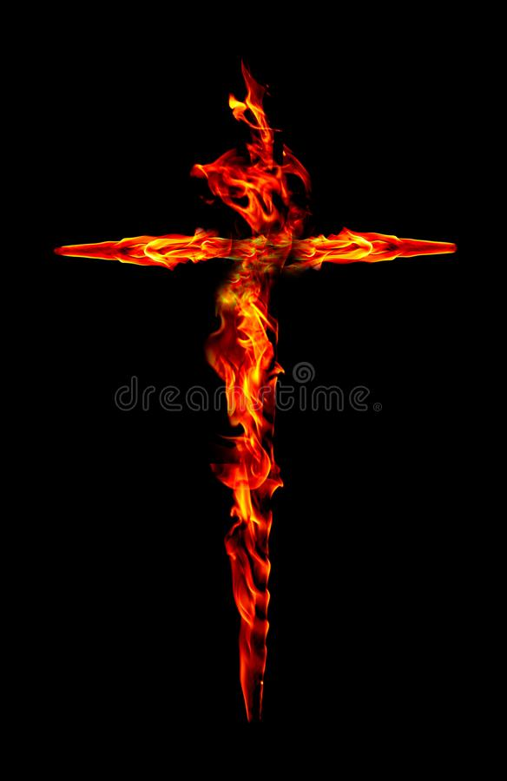
Therefore, the Lord himself shall give you a sign; Behold, a virgin shall conceive, and bear a son, and shall call his name Immanuel (Isaiah 7:14).
Behold, a virgin shall be with child, and shall bring forth a son, and they shall call his name Emmanuel, which being interpreted is, God with us (Matthew 1:23).

Slide 11
But he was wounded for our transgressions, he was bruised for our iniquities: the chastisement of our peace was upon him; and with his stripes we are healed (Isaiah 53:5).
They had platted a crown of thorns, they put it upon his head, and a reed in his right hand: And they spit upon him, and took the reed, and smote him on the head.and they crucified him, and there two thieves crucified with him, one on the right hand, and another on the left. (Matthew 27:29-30, 35, 38)

Slide 12
For thou wilt not leave my soul in hell; neither wilt thou suffer thine Holy One to see corruption (Psalms 16:10).
And that he was buried, and that he rose again the third day according to the scriptures (1 Cor. 15:4).

Slide 13
For all have sinned, and come short of the glory of God (Romans 3:23)
For God so loved the world, that he gave his only begotten Son, that whosoever believeth in him should not perish, but have everlasting life (John 3:16).
For God sent not his Son into the world to condemn the world; but that the world through him might be saved (John3:17).

Slide 15
https://youtu.be/H3EmIInI_Zo

Slide 16
QUESTIONS
QUESTIONS
COMMENTS

Slide 17
BEWHOLE UNIVERSITY-2021
Dates: February 13, 2022 @ 9:30am
Teacher, Prophetess Clark
Email: bwccuniversity@gmail.com
“Where becoming and being whole is our passion”
Class sign out is,
Christ

