Slide 1
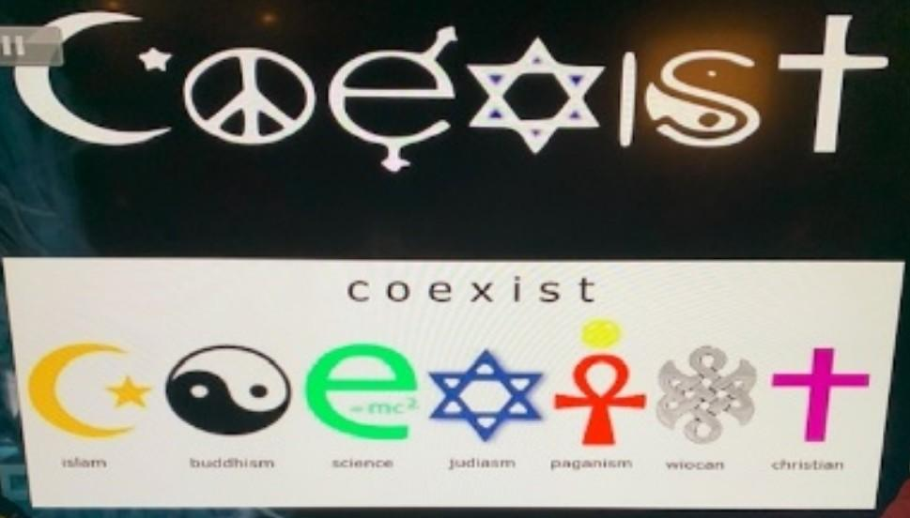

Slide 2
Christianity
Part 2

Slide 3
There’s 8 reasons why we should believe in Christianity
# 1) Virgin Birth
# 2) Jesus Christ proclamation as God
# 3) Relational God
# 4) Resurrected Leader
# 5) Inerrant Bible
# 6) Fulfilled Prophecy
# 7) Salvation
# 8) The Blood of Jesus

Slide 4
Why Should I Believe In Christianity
# 1) Virgin Birth- No other world religious leader can boast that they were born of a virgin. In all other religions the goal is to reach up. But in Christianty God says there is no way you can reach me. So He humble Himself and came down and dwelled with us. .
The virgin birth implied in the Old Testament as early as (Gen.3:15), which promise that “the seed” of a woman would be victor over satan and sin. It is expressly predicted (Isaiah 7:14). “Behold a Virgin will be with child and bear a son, and she will call His name Immanuel (Matthew 1:22), this prophecy was fulfilled in Mary.
The Virgin Birth was God’s miraculous intervention,producing offspring without a human father. No man or angel was involve. Christ, who was God from all eternity, took hold of this human nature thus conceived and joined it to HImself.
The fundamental need was found in the nature of the human race. Every normal, human birth produces another sinner, just as Adam, a sinner produced a race of sinners. Our savior had to be genuinely human and truly sinless in order to be our perfect substitute and pay our penalty of guilt before an infinite God by His death.

Slide 5
# 2) Jesus Christ as God-No other major world religious leader or founder made a claim to say that they were God or equal to God. ”I and the Father are one, before Abraham was I am (John 8:58). Implying that He existed with the Father eternally. Jesus also exercised His authority to forgive sins. Jesus at times also accepted the worship that only should have went to God.
He was with God in the beginning (John 1:2).
“And the word became flesh and dwelt amongst us, and we have seen his glory, glory as of the only son from the Father, full of grace and truth (John 1:14).
The Father and I are one (John 10:30), Jesus calmed the storm, recover the sight to the blind, and Jesus raised others from the dead and God raised Jesus from the dead.
“You must have the same attitude that Christ Jesus had. Though He was God, He did not think of equality with God as something to cling on to (Philippians 2:5).

Slide 6
# 3) Relational God-In other religions, God is some distant far off God. Because it’s more about rules and regulations (do this or do that) or you have to pray these many times. With God we can have a true relationship with Him.
In Christianity it’s believe that God was never bored, nor was there a time when He wasn’t full of love.
God wants to dwell with us. He wants to be apart of our lives.
God wants to be up close and personal with us.

Slide 7
# 4) Resurrected Leader-No other religious leader had died in full view of trained executioners, had a guarded tomb, and then rose on the 3rd day.
He later appeared to many people. The resurrection is proof of who Jesus is, and that He accomplished what He sat out to do. Jesus provided the only means for redemption for mankind. Only Jesus conquered death.

Slide 9
# 5) Inerrant Bible-(Bible without error). In the beginning was the Word, and the Word was with God, and the Word was God (John 1:1).
Many people have a book or some sort of source that is written by one person. But the Bible is written by forty different authors from many different walks of life over 1600 years and three continents. Most of whom did not know each other. Yet they all agreed on everything that’s in scripture without any error.We have 66 books and one central message, different styles and yet there are no contradictions found in scripture.
Unlike other religious text that teach advocating good works to please an unreachable god.
The Bible is unique in content, teaching the way of life
The Bible teaches freedom in Christ
The Bible is the inspired word of God
The Bible is unique in its results.
The Bible brings about a changed life.

Slide 10
# 6) Fulfilled Prophecy- We see prophecy after prophecy that was fulfilled with accuracy;
*Messiah would be born in Bethlehem (Micah 5:2).
*Messiah would come forth from the tribe of Judah (Gen. 49:10).
*Messiah throne would be anointed and eternal (Psalms 45:6-7).
*Messiah would be betrayed (Psalms 35:11).
*Messiah would be crucified with criminals (Isaiah 53:12).

Slide 11
# 7) Salvation-means to be rescue by God and preserved or delivered from harm, ruin, or loss. To be delivered from sin and its consequences. To be saved. Salvation is a gift, many other major religions focus on doing and doing. Making sure they check off their to do list. But in Christianity it’s not so much about doing works even though faith without works is dead. Jesus saves us first. Then He gives us the ability to do the work.
Our salvation begins the moment we accept Jesus as our Lord and Savior. This initial stage is the:
Judicial act called justification. Judicial means God is the Judge. And He declares the guilty innocent (Rom 3:21-26).
The second stage is the life long process of sanctification.
And the third stage of Christian salvation is glorification, or when we meet Christ in heaven.

Slide 12
# 8) The Blood of Jesus is so powerful. On the first Passover (Exodus 12:1-13), the blood of a lamb was posted on the top and sides of each door frame as a sign that death has already taken place, so the Angel of Death would pass over.
When God cut a covenant treaty with his people, Moses took the blood of a oxen and sprinkled half of it on the altar and half on the people of Israel (Exodus 24;6-8).

Slide 14
Seven places Jesus shed his blood for you and me.
The first place was the garden of Gethsemane
He won back our willpower (Matthew 26:39).
What is willpower-The ability to change, the ability to say yes or no and the ability to say yes to God and no to satan.
The second place Jesus shed His blood was the whipping post (Isaiah 53:5)
That means no disease or illness can beat us.
The third place Jesus shed His blood was through the Crown of thorns placed on His head (2 Corinthians 8:9).
and gave us our prosperity.

Slide 15
The fourth place Jesus shed His blood was through His pierced hands which won back dominion over the things we touch (Mark 16:18).
The fifth place Jesus shed His blood was through His pierced feet, which he won back dominion over the places we walk (Deut. 11:24).
The sixth place Jesus shed His blood was through His heart, He was heartbroken (Isaiah 53:3).
The seventh place Jesus shed His blood was His bruised feet. He went to hell and took back the keys to the kingdom and delivered us
from all of our sins and gave us joy (Nehemiah 8:10).

Slide 16
Christianity & Persecution in the Bible
Daniel 3:9-26-is an example of this persecution
The three Hebrew boys are thrown into the fiery furnace by Nebuchadnezzar, King of Babylon for refusing to bowed down to the King’s image.
Regardless of the outcome, they were committed to their faith, even when faced with a painful death. Because of their faith, God delivered them from the hand of the enemy and his evil and in doing so , brought the mighty King of Babylon to recognize His Lordship over heaven.
Part of the Christian way is persecution. All who follow Christ will suffer persecution. Yes, and all that will live Godly in Christ Jesus shall suffer persecution (2 Timothy 3:12).

Slide 17
https://youtu.be/NF2Xr7HPJ54

Slide 20
BEWHOLE UNIVERSITY-2021
s: February 13, 2022 @ 9:30am
Teacher, Prophetess Wright
abwccuniversity@gmail.com
“Where becoming and being whole is our passion”
CLASS SIGN OUT
SALVATION

