Slide 1
The OCCULT PART 2 BWCC UNIVERSITY
MIN Toya

Slide 2
The Question Prophetess Posed last week
How do I navigate the spiritual/invisible realm?
My first experience with an evil spirit at 15
In college the Book “He came to set the Captives Free”
Currently where I am in regards to my faith in the Lord
It’s noy by might nor by power but it’s by my Spirit says the Lord
Zechariah 4:6

Slide 3
What are some of the mainstream occult practices?
There are a slew of them but today I’m going to hone in on the holistic beauty, nutrition , wellness portion. Some call it New Age, Vibrations, energy, vibes etc…
We have all see it seductively and boldly incorporated into our mainstream life.
Many tv shows have been saturated with occult as if it were harmless entertainment
Examples: , zombies, Iyanla Fix my life (yourba priestess), Long Island medium, that’s so raven, bewitched, the twilight movies, wizards of waverly place, charmed, sabrina the teenage witch. Just to name a few

Slide 4
Hosea 4:6
Hosea 4:6
King James Version
⁶ My people are destroyed for lack of knowledge: because thou hast rejected knowledge, I will also reject thee, that thou shalt be no priest to me: seeing thou hast forgotten the law of thy God, I will also forget thy children.

Slide 5
Occult means hidden, secret, knowledge of the paranormal
Physical Sciences: astronomy, physics, chemistry , earth science. These we learned in school
Occult sciences : astrology, alchemy, natural magic (divination)
This reminds me of when Moses, Jospeh and Daniel were used by God to interpret dreams, and reveal God’s way when the rulers of the land magic tircks did not work.

Slide 6
Metaphysical stores-paranormal , unearthly, supernatural
Metaphysical stores are on the rise. I have seen them in Tinley Park and various local places. They sell things like wands, satanic oils, clothing, witches brooms, sgae kits etc.
Places like etsy have a huge occultic section and even the Sunrise the local healthfood store has items there that are demonic.
It is all around us but we have to keep our Godly Armor on Eph 6

Slide 7
Deut 18:9-12
⁹ When thou art come into the land which the Lord thy God giveth thee, thou shalt not learn to do after the abominations of those nations.
¹⁰ There shall not be found among you any one that maketh his son or his daughter to pass through the fire, or that useth divination, or an observer of times, or an enchanter, or a witch.
¹¹ Or a charmer, or a consulter with familiar spirits, or a wizard, or a necromancer.
¹² For all that do these things are an abomination unto the Lord: and because of these abominations the Lord thy God doth drive them out from before thee.

Slide 8
Hertitage House Rose Water

Slide 9
Vor –mag water is vortexed and magnetized to promote higher vibrations and energy

Slide 10
On the back of the rosewater edgar cayce a known medium has given readings to this popular hair and skin product

Slide 11
Although the company has changed it’s logo and removed the picture
It is still connected to this physic medium and is very popular among the natural hair care community. It is now called the Associataion for Research and Enlgihtnement . It sounds very innocent but when you research it it is still the same demonic company.

Slide 12
2 Timothy 2:15
¹⁵ Study to shew thyself approved unto God, a workman that needeth not to be ashamed, rightly dividing the word of truth.

Slide 13
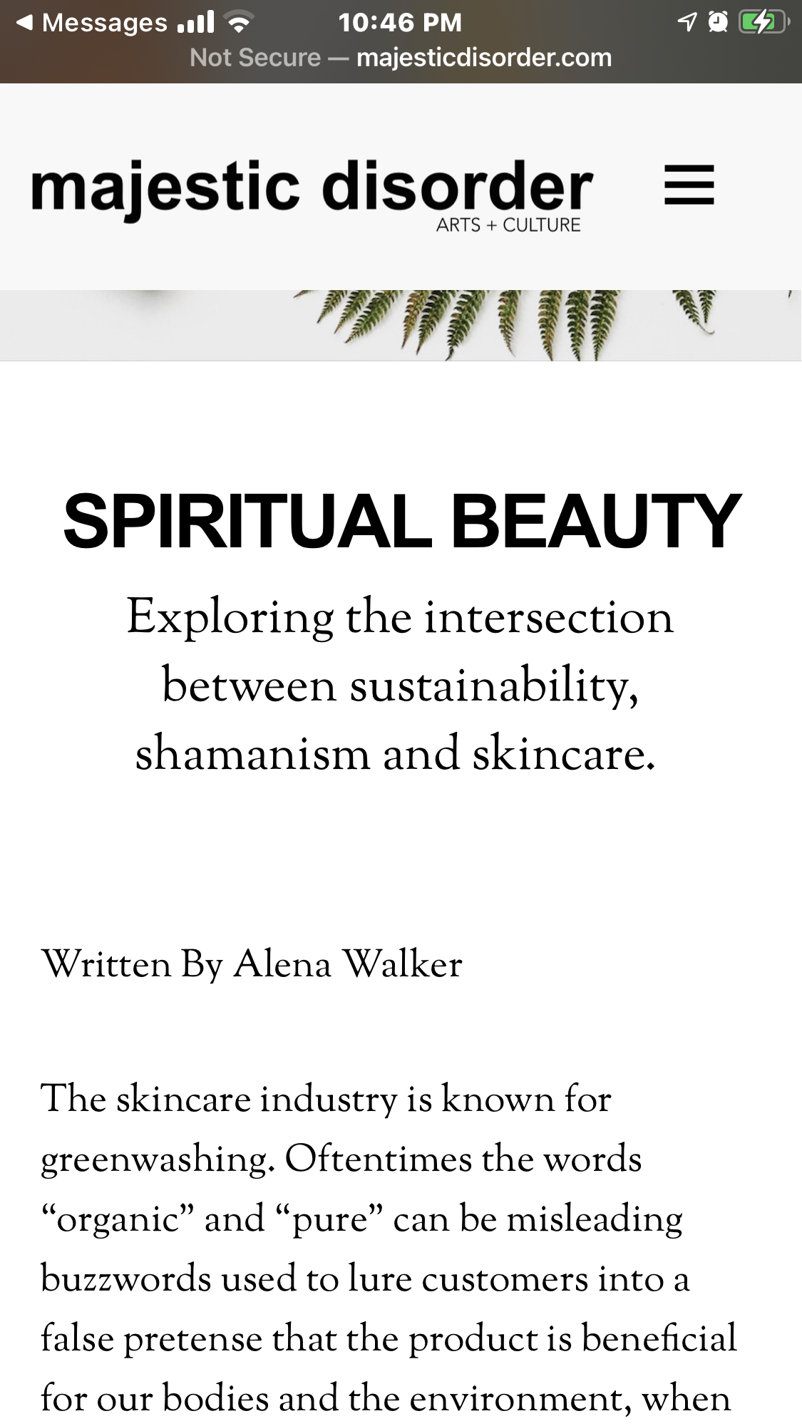
Spiritual Beauty
The occult is even seen in the skincare community. Buzz words like : pure, organic, natural, botanical , self care help to lure the masses in. One such company called Majestic Disorder uses those key words and a shaman.
Shaman is Priest or priestess who uses magic to cure the sick ,divining the hidden and controlling events.

Slide 14
Luke 10:19
¹⁹ Behold, I give unto you power to tread on serpents and scorpions, and over all the power of the enemy: and nothing shall by any means hurt you.

Slide 16
Secret Society
My personal jounrney

Slide 17
The Lord’s way is the only Way
Acts 16:16 DEUT 18:11
JERE 27:9
Rev 2:18
Isai 8:19
LEV 19:31
LEV 20:6
IS 48:17
MICAH 3:7

Slide 18
How do we navigate through the invisible realm?
By honoring God and obeying God in every area. It’s in His Word.

Slide 19
Class code
Class code is practioner

