Slide 1
WELCOME! WORLD RELIGIONS
BE WHOLE UNIVERSITY-2022
Chancellor: Prophetess Bendetta Clark
bwccuniversity@gmail.com
“Where becoming and being whole is our passion”
Sunday, March 6, 2022 @ 09:30 am

Slide 2
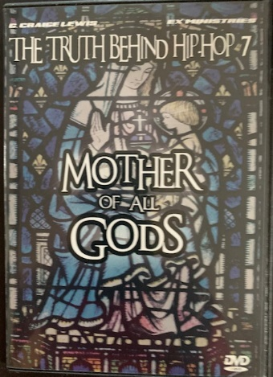
https://youtu.be/n19-wpbT_no

Slide 4
The parallels between the Roman church and ancient Babylon are striking, as we view the pagan state religion. “The mighty Catholic church was little more than the Roman Empire baptized”. ---A.C. Flick, The Rise of the Medieval Church (Putman’s 1909 ed.), pg. 148. Cardinal Newman lists many examples of things admittingly “of pagan origin” which that church introduced “in order to recommend the new religion to the heathen”; some examples, the use of temples and these dedicated to particular saints, ornamented on occasions with branches of trees, incense, lamps, and candles, votive offerings, on recovery from illness, holy water; holy-days and seasons, use of calendars, processions, sacerdotal vestments, turning to the East, and perhaps the ecclesiastical chant.

Slide 5
Laws granting, privileges and patronage, and thus enforcing church dogmas, practices, or disciplinary decrees, or suppressing paganism and heresy was the religious legislation that united the church and state. These laws also exempted clergy from military and civil duty (March, 313 AD). Enjoined the civil observance of Sunday, but not as dies Domini [Lord’s Day] but as dies Solis [the Sun’s Day]. State supervision was initiated through ecumenical or general council initially in 325 AD presided over by Constantine. First topics were Arian controversy and date of Easter.

Slide 6
Ancient Babylonian religion had immoral features, but modern Babylon commits spiritual fornication, polluting the church with false doctrines and pagan practices, and having illicit connection with secular powers to enforce her teachings; and like her ancient namesake, Roman Babylon has made many nations drink wine from her cup.

Slide 7
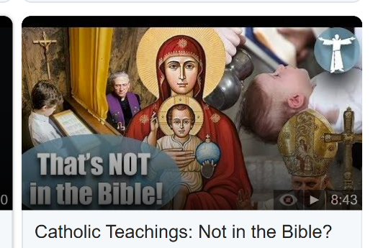
Ancient Babylon contributed to the “great and ubiquitous cult” of the virgin mother-goddess (queen of heaven, Jeremiah 7:18, 44:17-19, 25). Babylonian Ishtar is identified by such names as Astarte, Ashtoreth, Artemis (Diana) of the Ephesians (Acts 19:28, 34). The influence of astrological sun worship can be seen in the idea ---if not the mode---of purgatory. The adoption of December 25, the birthday of the invincible Sun, and the Mithraic Sunday, which later became Constantine’s famous Sunday law, served to unite his Christian & pagan subjects in the observance of the venerable day of the Sun. Other pagan survivals of Catholicism, orientation of church buildings and praying toward the East, especially from Isis’s worship; holy water; votive offerings, elevation of sacred objects, the priest’s bell, the decking of images, prayers for the dead, saint cults and relics.

Slide 13
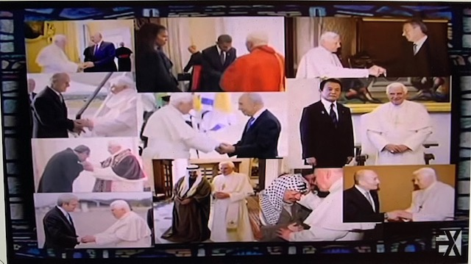
From East to West every head of state has had to acknowledge the pope. Signifying the pope as God on the earth.

Slide 15
⁹But ye are a chosen generation, a royal priesthood, an holy nation, a peculiar people; that ye should shew forth the praises of him who hath called you out of darkness into his marvellous light; ¹⁰ Which in time past were not a people, but are now the people of God: which had not obtained mercy, but now have obtained mercy (1 Peter 2:9-10).
(The Reformation is said to have begun when Martin Luther posted his Ninety-five Theses on the door of the Castle Church in Wittenberg, Germany, on October 31, 1517).

Slide 17
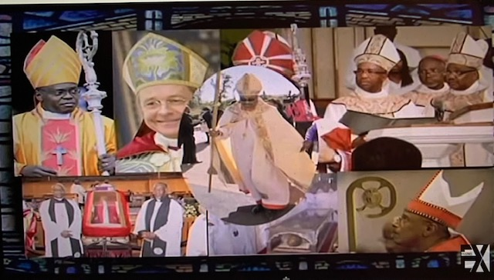

Slide 19
Christians vs Catholics:
Christianity is the largest religion in the world with over a billion followers worldwide. Catholicism is the largest denomination of Christianity with over a billion followers worldwide.
While both Christians and Catholics share many common beliefs, there are also some major theological differences between the two faiths.
1. Prayer
Christians pray to God alone. Christians pray privately, alone, or with other Christians.
Prayer
Catholics may also pray to saints and Mary, the mother of Jesus. Saints are people who have been canonized by the Catholic Church and believed to be in heaven. They can intercede on our behalf and help us with prayers.
Catholics also pray privately but they also have a number of prayers that are said as a group. Catholics also say prayers out loud in church, such as the Lord’s Prayer and the Hail Mary.
2. Belief on Salvation
Christians believe that Jesus is the only way to salvation (John 14:6). Christians believe that Jesus died for their sins and that they are saved by grace through faith
2. Beliefs on Salvation
Catholics believe that there are many ways to find salvation and that it can be found through different paths.
Salvation is not just about going to heaven when you die, it is also about living a good life and helping others.

Slide 20
2. Belief on Salvation
Catholics believe that Jesus died for our sins, but we are also saved by grace through faith and works. We must do good deeds to earn salvation. Catholics believe that you can lose your salvation if you do not follow the teachings of the Church or if you sin. You must confess your sins to a priest and ask for forgiveness in order to be forgiven and stay saved.
2. Belief on Salvation
Christians believe that Jesus died for their sins and that they are saved by grace through faith (Ephesians 2:8).
Christians believe that once you are saved, you are always saved.
3. Bible’s Authority
Christians believe in the Bible as their sole authority on faith and practice (John 1:1, 2 Tim. 3:16)
3. Bible’s Authority
Catholics also revere the Bible, but they also place a high value on church tradition and the teachings of the Catholic Church. The Bible is not the only source of authority for Catholics but it is one of the most important.
4. Cost of Salvation
Christians believe that salvation is a free gift from God.
4. Cost of Salvation
Catholics believe that good works are necessary for salvation and that it costs something to be saved. You must do good deeds and follow the teachings of the Catholic Church in order to be saved.

Slide 21
5. Belief on Fate
Christians believe in the doctrine of predestination. This means that they believe that God has already predetermined who will be saved and who will not be saved (Romans 8:29).
5. Belief on Fate
Catholics do not typically hold to this doctrine.
6. Baptism
Christians baptize infants as a sign of God’s covenant with His people.
6. Baptism
Catholics also baptize infants, but they do not believe that this is necessary for salvation.
7. Role of Mary
Christians generally do not give Mary as much attention as Catholics do.
7. Role of Mary
Catholics place a high value on Mary and consider her to be the “Mother of God.” They often pray to her and ask for her intercession (Jeremiah 7:18, 44:17-19, 25).

Slide 22
8. Purgatory
Christians do not believe in purgatory.
8. Purgatory
Catholics believe that after a person dies, they may go through a period of purification before entering heaven.
9. Eucharist (Communion-Last Supper of Jesus)
Christians believe that the bread and wine used in Communion are symbolic of Jesus’ body and blood (1 Cor. 11:26).
9. Eucharist
Catholics believe that the bread and wine actually become the body and blood of Jesus during Communion.
10. Confession
Christians typically do not confess their sins to a priest (1 John 1:9).
10. Confession
Catholics are required to confess their sins to a priest in order to receive forgiveness.
11. Priesthood
Christians do not believe in the Catholic concept of the priesthood (1 Peter 2:9).
11. Priesthood
Catholics believe that only men can be priests.

Slide 23
12. Marriage
Catholics believe that marriage is a sacrament and that it can be between two people of the opposite sex or the same sex.
12. Marriage
Christians and Catholics have different views on marriage. Christians believe that marriage is a lifelong covenant between a man and a woman.
13. Salvation for Children
Catholics believe that infants are not born into sin and do not need to be baptized in order to go to heaven.
13. Salvation for Children
Christians believe that children are born into sin and that they must be baptized in order to receive salvation.
14. Church Hierarchy
Catholics have a strict hierarchy of bishops, priests, and deacons.
14. Church Hierarchy
Christians do not have a church hierarchy like Catholics do.
15. Celibacy
Catholics believe that celibacy is a higher calling and requires priests to remain unmarried.
15. Celibacy
Christians do not require celibacy for their clergy.
16. Geographical Differences
while the Catholic Church is primarily based in Europe and Latin America.
16. Geographical Differences
Christians are found all over the world.

Slide 25
BE WHOLE UNIVERSITY-2022
Chancellor: Prophetess Bendetta Clark
bwccuniversity@gmail.com
“Where becoming and being whole is our passion”
Sunday, March 6, 2022 @ 09:30 am
CLASS SIGN-OUT
ROMAN

