Slide 1
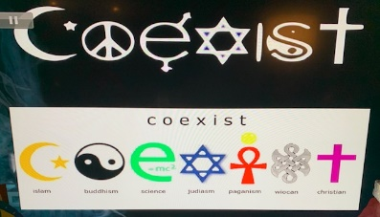
WELCOME!
WORLD RELIGIONS
BE WHOLE UNIVERSITY-2022
Chancellor: Prophetess Bendetta Clark
bwccuniversity@gmail.com
“Where becoming and being whole is our passion”
Sunday, April 3, 2022 @ 09:30 am

Slide 2
Apart from Christianity Islam is arguably the most influential religion on earth. It is the second largest religion in the world and the powerful resurgence of Islamic fundamentalism continues to spread the Muslim faith in more moderate Islamic nations.
“Islam” is the correct name for the religion that the Muslim prophet Muhammad founded (570-632 A.D.) claiming God (Allah) revealed to him through the angel Gabriel beginning in 610 A.D. Because Muhammad was uneducated these revelations were first memorized then later written down by his followers (as he did not learn how to read or write). The name is drived from the infinitive of the Artabic verb “to submit” (i.e., to Allah’s will).
Muslim is the correct term for a follower of Islam and comes from the present participle of the same verb.

Slide 3
Islam today is comprised of two principle schools the majority Sunni school (90%) and the
minority Shi’ite (10%). In addition there are millions of Muslim mystics called Surfis.Muslim
influence is seen ion the traditional Islam as well as the militant, racist black Muslim
movement.
The adult Muhammad soon showed signs of a markedly religious disposition. He would retire to
caves for seclution and meditation; he frequently practiced fasting and he was prone to (revelationary)
dreams…He was generous, resolute, genial and astute, a shrewd judge and a born leader of men. He could, however, be cruel and vindictive to his enemies: he could stoop to assasination, and he was undeniably sensual. One of the modern day biographers of the modern era Robert Payne, observes that “violence and gentleness were at war within him.” However at the end of his life, Muhammad failed to name a successor. This failure resulted in the major division of Islam into the majority Sunni and minority Shi’ite branches, each claiming to be true Islam.

Slide 4
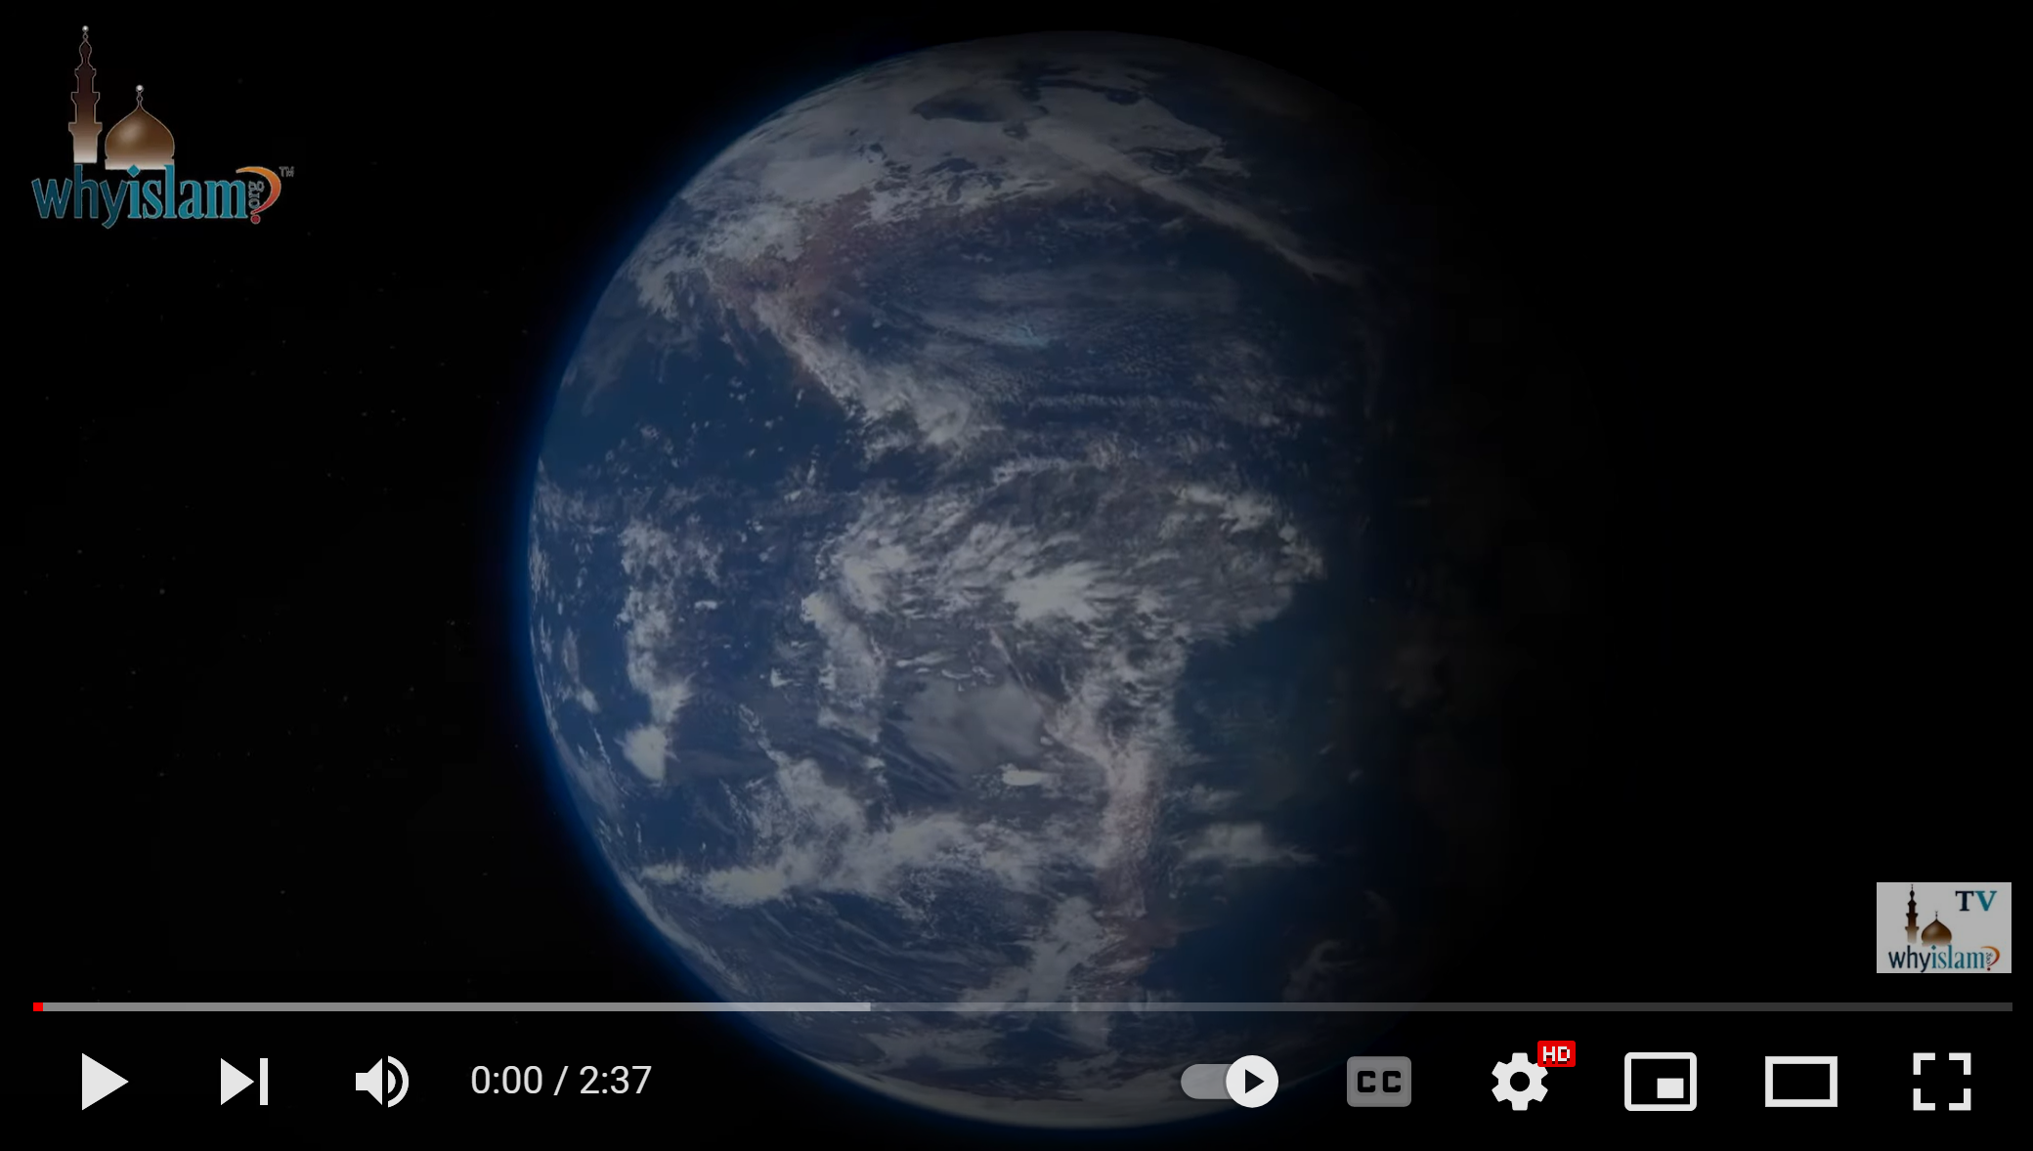
https://youtu.be/2cyfeAdnEJI
Six Main Beliefs
in Islam Explained

Slide 5
Every Muslim must hold to six beliefs or articles of the Islamic faith. They are:
Faith in Allah-Muslims believe there is only one true God and that his name is Allah. His will is
supreme.
2. Angels-Muslims believe in angels---such as “Gabriel” who allegedly transmitted the Koran (Quran) to
Muhammad.
3. Their Holy Books, “Koran” (Quran)-Muslims believe that Allah has given a long series of revelations,
including the Old and New Testaments. But these revelations end with the Koran which supersedes and
to a large degree abrogates (or does away with) the others and they accept that only the Koran is the Word of God. For
example they believe allah’s earlier revelations in the Bible have been corrupted and/or falsely interpreted by Jesus and
Christians and therefore, require the Koran to be understood properly.
4. Prophets-Muslims believe Allah has sent 124,009 prophets to mankind, although only about 25 are mentioned in the Koran. Six of the principal prophets are: Adam the chosen of Allah, Noah, the preacher of Allah, Abraham the friend of Allah, Moses, the speaker of Allah, Jesus the word of Allah, and Muhammad, the apostle of Allah.
Because Muhammad’s revelations is considered the greatest of all, he is called the “Seal of the Prophets,” “Peace of the World” and given over 20-0 other appellations.
5. Predestination-Muslim’s believe everything tha happens, both good and evil, is predestined by Allah’s will, his immutable decree.
6. The Day of Judgment-Muslimns believe thaty on this day the good and evil deeds of men will be placed on a “scale.” Those Muslims having sufficient personal merit and righteousness (and the favor of Allah) will go to heaven, all others will go to eternal hell.

Slide 6
Religious Duties required of all Muslims:
Muslim must practice at least five fundamental duties known as the Pillars. They are
considered obligatory--observances upon which successful practice of the Muslim faith rests.
The reciting of the creed of Islam: “There is no God but Allah and Muhammad is his prophet.”
2. The Muslim must recite prescribed prayers 5 times a day.
3. Observing the month of fasting call Ramadan. This fast commemorates the first revelation that
Muhammad received in 610 A.D.
4. The giving of alms to the poor Muslims are required to give 2.5% of their currency plus other forms of
wealth, as determined by a complicated system.
5. The 5th and last duty is that of a pilgrimage to Mecca, Muhammad’s place of birth. This is required during the
lifetime of every Muslim who is physically and financially able to make the trip, unless he is a slave.
6. A sixth religious duty maybe associated with the above 5 pillars, although it may be considered optional. This is
the Muslim holy war or jihad. Jihad may be interpreted as internal(as spiritual struggle) or external defending
Islam. Anyone who dies in a holy war is allegedly guaranteed eternal in heaven and is considered a martyr for
Islam.

Slide 7
Islam vs. Christianity
(Islam)-The Koran stresses that Allah is one person only. The Koran emphasizes that Christians are
unbelievers because they accept the historic Christian doctrine of the Trinity.
(Christianity)-God has revealed himself as a triune Being, the One God eternally existing in three person—
Father, Son and Holy Spirit (Matt. 28:19; John 1:1, 14; Acts 5:3-4). Christians do not believe in three gods,
the idea is a clear misrepresentation of Christian belief.
(Islam)-The Muslim God has a different character than the Christian God, that of the “99 names used for Allah,” which Muslims memorize and use for worship, not one of these names is “love” or “loving.” The Koran stresses that Allah only loves those that who do good and that he does not love those who are bad. Allah emphasizes that he does not love the sinner.
(Christianity)-The biblical God does love the sinner ---in fact, he loves all sinners. God does not love the sin but he loves the sinner. ⁶ For when we were yet without strength, in due time Christ died for the ungodly. 8 But God commends his love toward us, in that, while we were yet sinners, Christ died for us. 10 For if, when we were enemies, we were reconciled to God by the death of his Son, much more, being reconciled, we shall be saved by his life (Romans 5:6, 8, 10). The Bible declares, “God is love” (1 John 4:6).
(Islam)-Allah is ultimately unknowable and incomprehensible. Allah is the unique, unexplorable, and inexplicable one---the remote, vast and unknow God. People cannot know Allah and should not even try to know him. According, to the Islamic doctrine of Allah, he is nonrelational.
(Christianity)- And this is life eternal, that they might know thee the only true God, and Jesus Christ, whom thou hast sent (John 17:3). I am the good shepherd, and know my sheep, and am known of mine (John 10:14). That the God of our Lord Jesus Christ, the Father of glory, may give unto you the spirit of wisdom and revelation in the knowledge of him (Ephesians 1:17). …for I know whom I have believed… (2 Tim. 1:12).

Slide 8
Islam vs. Christianity
(Islam)-Muslims praise Jesus as a prophet of God, as sinless, as “the Messiah,” as “illustrious in this world
and the next. As the Word of Allah and as the Spirit of God. Islam asserts that Jesus was merely one of God’s
many prophets or messengers and not God’s only Son. Thus the Koran emphatically denies that Jesus Christ,
is the Son of God. Muslims do not believe that Jesus was crucified and died on the cross. They believe Allah
would not permit this to one of his special prophets.
(Christianity)-The Bible teaches that Jesus Christ is God’s one and only Son. John 3:16, 18 Matt. 11:27; 26:64). God himself at Jesus’ baptism declares that Jesus is God’s son (Matt. 3:17, 17:5, Romans 1:3, 1 John 5:9-12).
(Islam)-The Muslim assumes that his chances for heaven are good if he;
1. Accepts only the Muslim God Allah and his prophet Muhammad,
2. Does good works and all that is required of him by Allah (e.g. the pillars of religion)
3. If he is predestined to heaven by Allah’s favor.
(Christianity)-forgiveness is based upon the death of Jesus Christ on the cross as a past action. Meaning once a person receives Christ as his/her Savior, all of his/her sins are forgiven and each one is guaranteed a place in heaven.
(Islam)-Teaches that Jesus Christ was neither crucified nor resurrected, therefore salvation cannot possibly be had through faith in Jesus Christ.
(Christianity)-says in, Revelation 1:18 Jesus taught, “I am the Living One, I was dead, and I am alive for ever and ever!”
(Islam)-Muslims also say that Jesus Christ will not return at the Second Coming.
(Christianity)-But in Matthew 16:27 and 25:31 and elsewhere Jesus also predicated His literal, physical return to the earth to set up His millennial/eternal kingdom.

Slide 9
 | The Koran | The Bible
God | Unitarian | Trinitarian
Jesus | A man | God incarnate
Salvation | By works, uncertain | By grace, assured

Slide 10
Islam Unveiled Documentary
https://youtu.be/uBvFX3xzQbk

Slide 12
BEWHOLE UNIVERSITY-2021
Dates: April 03, 2022 @ 9:30am
Teacher, Prophetess Clark
Email: bwccuniversity@gmail.com
“Where becoming and being whole is our passion”
Class sign out is,
ALLAH

