Slide 1
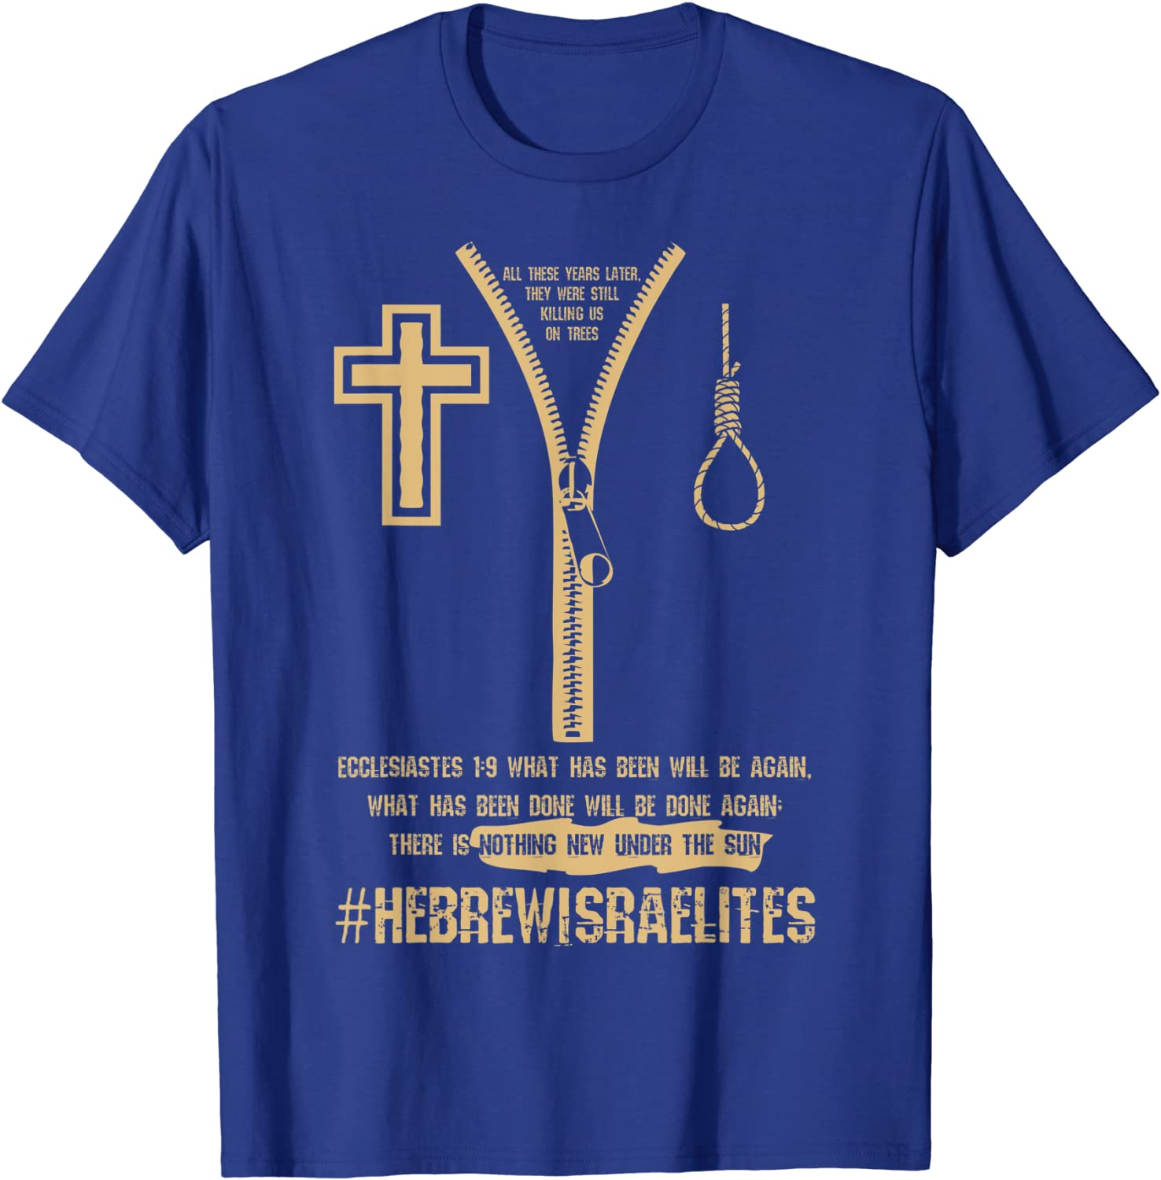
Hebrew Israelites
BeWhole University 2022
Part 1

Slide 2
Black Hebrew Israelites (also called Hebrew Israelites, Black Hebrews, Black Israelites, and African Hebrew Israelites) are groups of African Americans who believe that they are the descendants of the ancient Israelites. Some sub-groups believe that also Native and Latin Americans are descendants of the Israelites as well. Black Hebrew Israelites combine elements to their teaching from a wide range of sources: to varying degrees, Black Hebrew Israelites incorporate certain aspects of the religious beliefs and practices of both Christianity and Judaism, though they have created their own interpretation of the Bible, and other influences include Freemasonry and New Thought, for example. Many choose to identify as Hebrew Israelites or Black Hebrews rather than Jews in order to indicate their claimed historic connections.

Slide 3
Black Hebrew Israelites are not associated with the mainstream Jewish community, and they do not meet the standards that are used to identify people as Jewish by the Jewish community. They are also outside the fold of mainstream Christianity, which considers Black Hebrew Israelism to be heresy. Black Hebrew Israelism is a non-homogenous movement with a number of groups that have varying beliefs and practices. Various sects of Black Hebrew Israelism have been criticized by academics for their promotion of historical revisionism.

Slide 4
The Black Hebrew Israelite movement originated at the end of the 19th century, when Frank Cherry and William Saunders Crowdy both claimed to have received visions that African Americans are descendants of the Hebrews in the Bible; Cherry established the Church of the Living God, the Pillar Ground of Truth for All Nations, in 1886, and Crowdy founded the Church of God and Saints of Christ in 1896. Subsequently, Black Hebrew groups were founded in the United States during the late 19th and early 20th centuries, from Kansas to New York City, by both African Americans and West Indian immigrants. In the mid-1980s, the number of Black Hebrews in the United States was between 25,000 and 40,000.

Slide 5
The Black Hebrew Israelites’s claims of Jewish heritage provoked substantial debate in Israel. Israeli law offers citizenship for all Jews throughout the world, but the Black Hebrew Israelites could produce no evidence to substantiate their Jewish heritage. After much investigation, the Chief Rabbinate of Israel thus decided that the Black Hebrew Israelites were not really Jewish and were not entitled to citizenship.
The Black Hebrew Israelites entered Israel with temporary visas, which were periodically renewed while the government considered their claims to citizenship. They were allowed to live, work, and receive health care in Israel and were given loans so they could meet their basic needs. However, their non-citizen status did not provide the free education for their children, tax exemptions, and loans for permanent settlement that were available to Jewish immigrants.

Slide 6
Hebrew Israelite groups gather and proselytize in metropolitan areas. This group is usually made up of black and brown Americans who claim to be the true Israelites and that modern day Jews are impostors. Their presence in America has increased over the past decade. They have stepped up their efforts and are growing - both online and on the streets. This is a current cultural issue, especially in the urban community.
If you live in a major city and haven’t met a Hebrew Israelite yet, give it time – you will. Whether clad in camo or purple and gold, the Hebrew Israelites go where you go. Yelling, swearing, debating, pointing, and loudly pontificating; they go hard. They usually pick a favorite spot and post up every Saturday. In Phoenix, I’ve seen them at the light rail station, the State Fair, Super Bowl XLIX, Arizona State University and the Occupy Phoenix protests. They’ve even been known to storm in churches and disrupt services.

Slide 7
Some think this group is obscure and irrelevant. Amar’e Stoudemire disagrees. The former Phoenix Sun and NBA star identifies as a Hebrew Israelite. When SB1070 (a controversial immigration bill) was the hot topic in Arizona, Stoudemire tweeted out his disagreement with the legislation. The reason? The “Latin community” is part of “the 12 tribes of Israel,” which is, “one nation under Yah.” Stoudemire is an executive producer of “Village of Peace”, a documentary about Chicago-based Hebrew Israelites moving to Israel in the 60’s. He’s applied for Israeli citizenship and is part owner of an Israeli basketball team. I could go on: St. Louis rapper Chingy of “Right Thurr” fame and Antoine Dodson of “Bed Intruder” fame both came out as Hebrew Israelites. Boyz II Men crooners Shawn Stockman and Wayna Morris claim this faith. Whitney Houston visited a Hebrew Israelite leader when she went to Israel. Hebrew Israelite influence outweighs their numbers.

Slide 8
Black Hebrew Israelites, byname of the Original African Hebrew Israelite Nation of Jerusalem, African American religious community in Israel, the members of which consider themselves to be the descendents of a lost tribe of Israel. Black Hebrew Israelites hold religious beliefs that differ from those of modern Jewish communities in Israel. Black Hebrew Israelites permit polygamy and forbid birth control. Leaders decide who will marry and whether marriage annulments will be permitted, and they perform wedding ceremonies. Black Hebrew Israelites are vegans, avoiding the consumption of meat, dairy, eggs, and sugar. Members adopt Hebrew names to replace names they believe could be derived from slavery.
Most Black Hebrew Israelites live in Dimona, Israel, with the first ones arriving in that country in 1969. The group began in Chicago in 1967 under the leadership of Ben Ammi Ben Israel, an African American whose birth name was Ben Carter. Ben Israel appointed 30 disciples and in 1967 moved the group to Liberia before embarking for their final destination in Israel.

Slide 9
10 Hebrew Israelite Beliefs
1) Hebrew Israelites believe those whose ancestors were put in bondage during the Trans-Atlantic Slave Trade are the true descendants of Biblical Israel.
2) Hebrew Israelites believe modern day Israelites and Europeanized Jews are impostors and not the real descendants of true Israel.
3) Hebrew Israelites usually hold the King James Version of the Bible as authoritative. Some only hold to the Old Testament. Most hold to the Apocrypha as well.

Slide 10
Study Tools used.
Old Testament and some use the New Testament
Apocrypha
Cepher

Slide 11
4) Hebrew Israelites believe the “time of the Gentiles” means “the time of the white Europeans”, whom they refer to as Edomites or Esau. They believe this time is almost over; America and its allies will soon be judged.
5) Hebrew Israelites believe righteousness is achieved by law keeping. Strict Sabbath-keeping, dietary restrictions and a certain physical appearance is important (e.g., fringes and beards are good).
6) Hebrew Israelites believe Jesus Christ (although they use a different name - “Yahshuah” - or some other name) was a black man.

Slide 12
Many (not all) Hebrew Israelites believe “Edomites” (white people) can’t be saved. They are destined to be killed or slaves for Hebrew Israelites after the Messiah returns. Others believe “Gentiles” (non-Hebrew Israelites) can be grafted into the Kingdom if they keep the law and are under the authority of a Hebrew Israelite.
8) Hebrew Israelites believe both heaven and hell are conditions – mere “states of mind”. Neither are viewed as metaphysical realities as they are in orthodox Christianity.

Slide 13
9) Hebrew Israelites are usually part of the Sacred Name movement: they believe you must refer to God as “Yah” (or some other name). Their preference for God’s name usually depends on their individual sect (which they call “camp”).
10) Hebrew Israelites believe by spreading their message they are gathering the scattered Israelites who do not yet know their true ancestry and heritage. In essence, their mission is to build a nation.

Slide 14
Five Common Practices/Characteristics
1) On the street, Hebrew Israelites tend to be boisterous, belligerent and bold. They blurt, blare and bellow. If you engage a member on the street, be prepared for a noisy encounter. They often enjoy shouting obscenities at pedestrians and onlookers, especially those whom they deem to be morally repugnant (e.g., women wearing pants, black-and-white couples, etc.).

Slide 15
2) Hebrew Israelites craft their own signage. Common images include politicians with devil horns, “white Jesus” portrayals, images of slavery (men with scarred backs, slave ship diagrams, etc.) and the all-important 12 Tribes of Israel genealogy chart. For example, the Tribe of Judah is said to be the ancestors of black Americans, Isaachar for Mexicans and Gad for Native Americans.
3) Hebrew Israelites travel in groups. I’ve seen anywhere from three to a dozen congregate.

Slide 16
4) Hebrew Israelites members love to carry tattered old Bibles. Their messages include heavy doses of Scripture. Usually, there is a primary speaker and then a Scripture reader. The speaker will shout a verse to the reader - “Give me that Deuteronomy 28!” – and then the reader yells it out – loudly.
5) Most Hebrew Israelites will engage you – to a certain extent. If they view you as “having a demon” (a common accusation they make against opponents), they act dismissive and aggressive. If they see you as interested (but not too “talky”), they love the chance to lecture and even “cross-examine” you (“What does ADAM mean?” “What does Judah mean?”).

Slide 17
Remember, it’s not just knowledge they need; the Hebrew Israelites need to see authentic love, joy, peace, kindness, goodness, gentleness, faithfulness, self-control and patience. If you are going to converse with them, ask the Lord for a double-dose of the last one – patience.
If you know the Bible well and are quick on your feet, they may show some extra respect to you, but then again, they may become more irritated than usual – it all depends on the makeup of the group and the nature of the crowd. As you can imagine, engaging a Hebrew Israelite in this environment can be intimidating.

Slide 18
If you run into a Hebrew Israelite, you’d be wise to know what they believe. Even though they often yell and curse, knowing something about their ideology can assist you in having a more productive dialogue.
If you are a Christian, you should engage Hebrew Israelites when you see them. Why? They will benefit from well-informed brothers and sisters in Christ dropping knowledge. If you call yourself a Christian but don’t know your stuff, study up and come back – they eat the biblically ignorant alive!

