Slide 1
ROMAN CATHOLICISM
PART 2- MIN tOYA

Slide 2
QUICK OVERVIEW
Last week we learned about the history and beginnings of roman Catholicism
Constantine the great
Errors of the pope
Worship of mary
Major differences between protestant (Christians ) and catholics

Slide 3
Overview continued
Constantine the great compromised CHRISTIANITY WITH PAGAN REGLIONS THAT SURROUNED IT-THAT’S ONE OF THE FUNDAMENTAL FOUNDATION OF THE CATHOLIC CHURCH
ERRORS OF THE POPE “THE pOPE DOETH WHATSOEVER HE (WILLS) EVEN THINGS UNLAWFUL, AND IS MORE THAN gOD (QUOUTED BY nEWTON, P.45
WORSHIP OF MARY –GOES BY OTHER NAMES SUCH AS ASTARTE, ASHTORETH, ARTEMIS (DIANA) –EPHESIANS ACTS 19:28-34) WE APRECIATE mARY BUT SHE DID NOT TAKE AWAY OUR SINS BY DYING ON THE CROSS

Slide 4
ST. Thaddeus school –My personal experience
I attened a catholic school right around the corner form here on 9540 s Harvard grades 4th6th . I believe the reason we went was simply for afterschool care and my folks not truly realizing the errors of the catholic ways. I want to delve a little deeper into some of the traditions( background) and how they are unbiblical

Slide 5
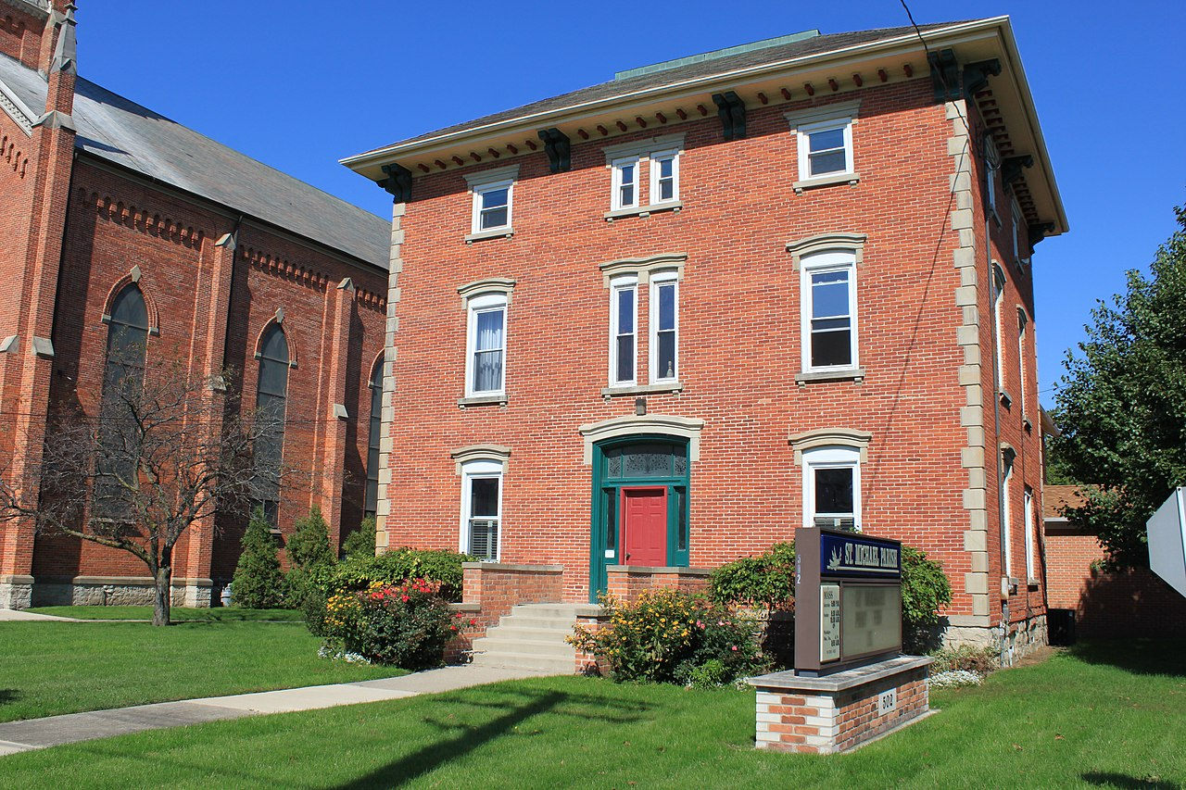
RECTORY
A RECTORY IS THE HOUSING THAT A CHURCH ORGANAZATION PROVIDES FOR A MINISTER OR PRIEST TO LIVE IN. mOST RECTORIES ARE CLOSE TO THE CHURCH
This Photo by Unknown Author is licensed under CC BY-SA

Slide 6
SACRAMENTS OF CATHOLICISM
The 7 Sacraments celebrated in the Catholic Church are Baptism, Confirmation, Eucharist, Penance and Reconciliation, Anointing of the Sick, Holy Orders, and Matrimony. They are divided into three categories: Sacrament of Initiation, Sacraments of Healing, and Sacraments at the Service of Communion. A List of The 7 Sacraments
In other words these sacraments can usher you into the Lord’s good graces but the bible says in Ephesians 2:8 for by grace you have been saved through faith. Our works will never pay for salavation.

Slide 7
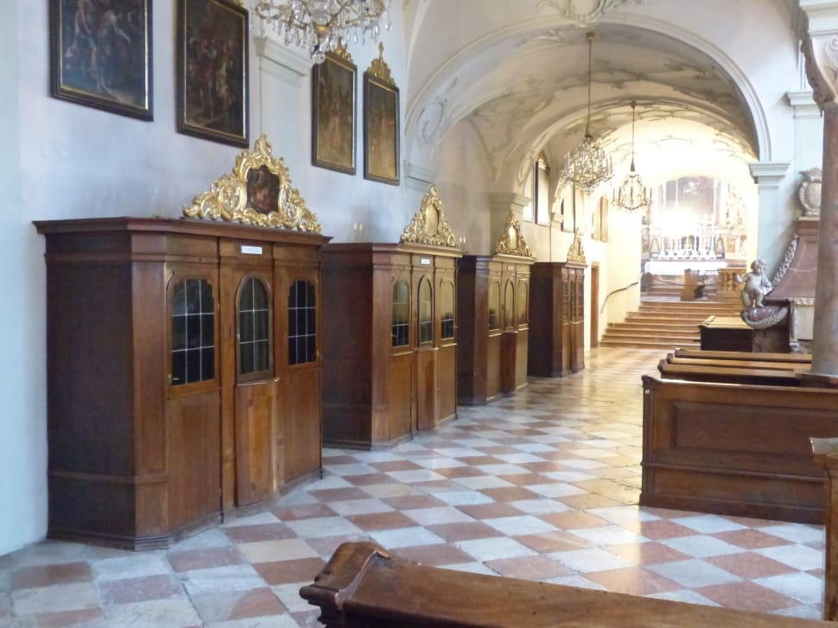
RECONCILIATION IN THE CATHOLIC CHURCH-SACRAMENT
THIS IS ALSO KNOWN AS CONFESSION . IN THE ROMAN CATHOLIC CHURCH PEOPLE GO TO CONFESSION TO SAY SORRY FOR THE WRONG (SIN) IN THEIR LIVES AND TO EXPERINCE GOD’S HEALING THROUGH FORGIVENESS. CONFESSION ALSO PERMITS RECONCILIATION WITH THE CHURCH WHICH IS WOUNDED BY THE SINS THE PEOPLE COMMIT.
HTTPS ://WWW.BBC.CO.UK

Slide 8
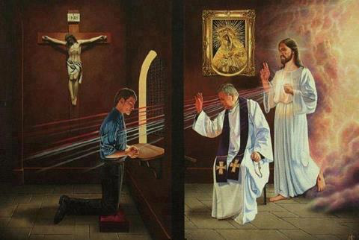
THE PROCESS OF CONFESSION TO EARTHLY PRIEST
God is our refuge and strength, an ever-present help in trouble.
Psalm 46:1
⁵ Stay away from the love of money; be satisfied with what you have. For God has said, “I will never, never fail you nor forsake you.” Hebrews 13:5
This Photo by Unknown Author is licensed under CC BY-NC-ND

Slide 9
JESUS IS THE GREAT HIGH PRIEST
Jesus the Great High Priest
¹⁴ Therefore, since we have a great high priest who has ascended into heaven,^{[a]} Jesus the Son of God, let us hold firmly to the faith we profess.¹⁵ For we do not have a high priest who is unable to empathize with our weaknesses, but we have one who has been tempted in every way, just as we are—yet he did not sin. ¹⁶ Let us then approach God’s throne of grace with confidence, so that we may receive mercy and find grace to help us in our time of need.
HEBREWS 4:14-16

Slide 10
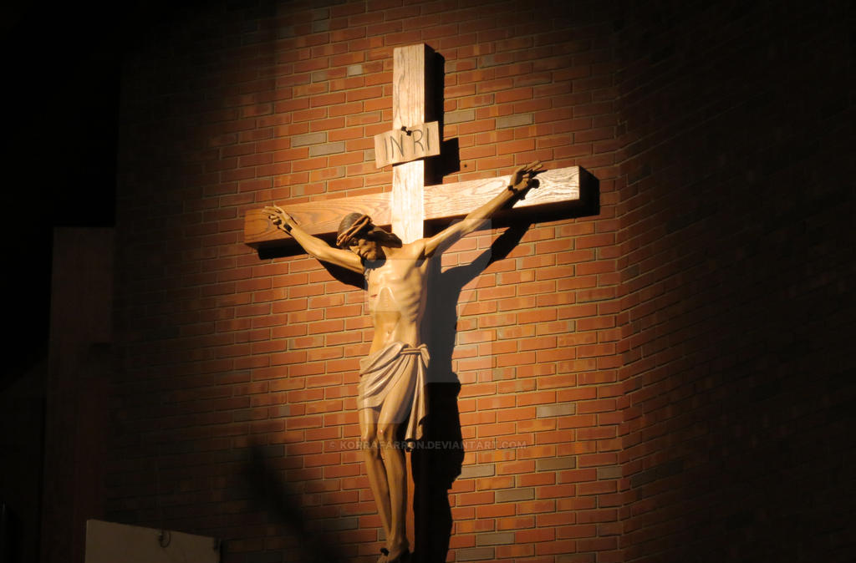
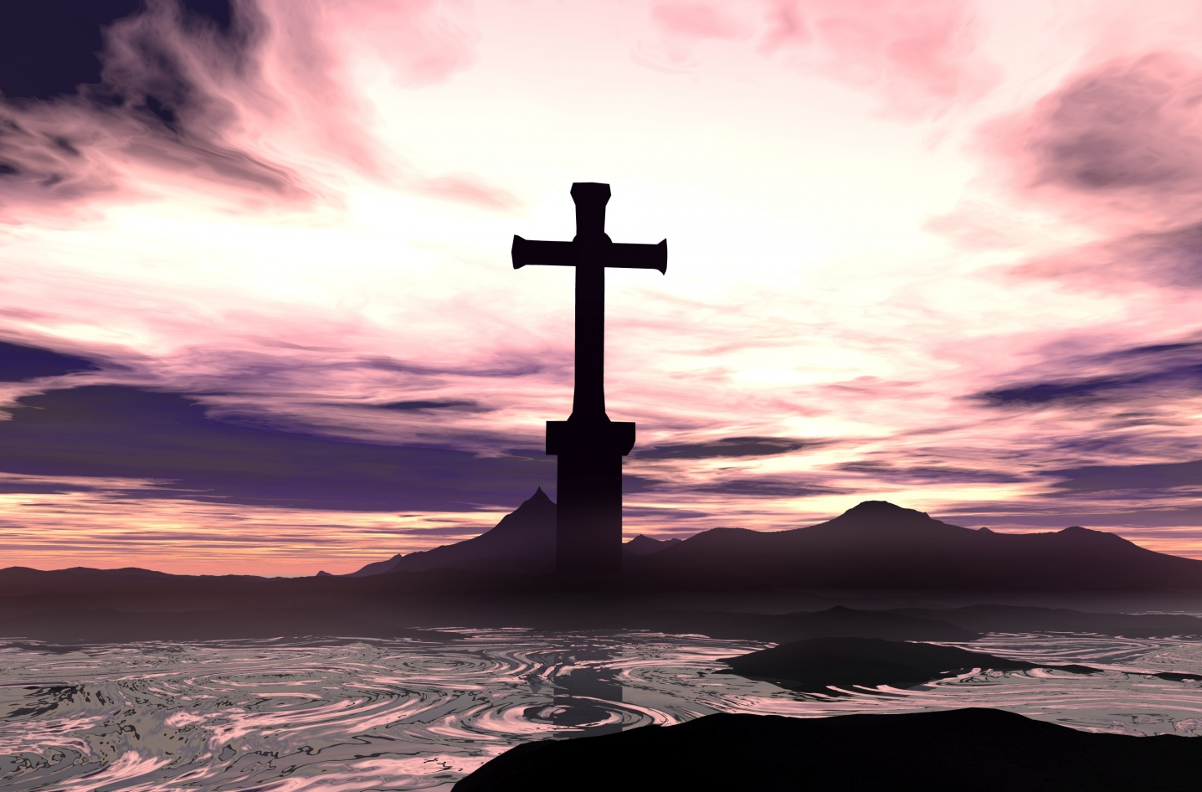
WHY IS JESUS STILL ON THE CROSS IN THE CATHOLIC CHURCH
CRUCIFIX VS THE CROSS- tHE CRUICIFIX MAGNIFIES HIS SUFFERING WHILE THE CROSS EXEMPLIFIES THE RESSURECTION . Its simply not an accurate real time portrayl of Christ.
WITH ALL POWER IN HIS HANDS- the empty cross
Refer to Matthew 28
This Photo by Unknown Author is licensed under CC BY-NC-ND

Slide 11
MASS
Mass (religion ) the ritual of chants, readings, prayers, and other ceremonies used in the celebration of the EUCHARIST IN ROMAN CATHolic church
Eucharist – we learned last week is a sacrament but Catholics believe it turns into his blood and body- we know it is symbolic but taken with honorably.
Matthew 6 Prayer⁵ “And when you pray, do not be like the hypocrites, for they love to pray standing in the synagogues and on the street corners to be seen by others. Truly I tell you, they have received their reward in full. ⁶ But when you pray, go into your room, close the door and pray to your Father, who is unseen. Then your Father, who sees what is done in secret, will reward you. ⁷ And when you pray, do not keep on babbling like pagans, for they think they will be heard because of their many words. ⁸ Do not be like them, for your Father knows what you need before you ask him.

Slide 12
Catholic churches
Are very oranate and filled with statues, crucifixes, kneeling pews, pictures of saints, stain glass, holy water, confessional boxes.
Very ritualistic and life less
I have heard of spirit filled catholic churches-father pfleger at st.sabina but it is filled with controversy and popular media attention.
This Photo by Unknown Author is licensed under CC BY-SA

Slide 13
RELIGIOUS VS RELATIONSHIP
God wants an eternal relationship with us as His children. Paul tells us that "God our Savior... desires all men to be saved and to come to the knowledge of the truth" (1 Timothy 2:3-4). God has planned a way to make this relationship available to every human being according to His timetable.
1 John 4:19 19 We love because he first loved us .

Slide 14
Relationship with the Lord
1
Read and study the Bible as a personal books and letters, all from God to you.^{[1]} To get to know God, you must first listen to what He has to say. Start from the beginning with the book of Genesis and gradually read your way through the end of the book of Revelations. Alternatively, you might start with the book of John to gain understanding of the story of Christ, and how he provided for your life in God. He finished the Plan of Salvation so that no one should be lost or alone, but that all should walk in new life in Christ.

Slide 15
Religion or religious
What is meant by being religious?
1 : believing in God or gods and following the practices of a religion a religious person. 2 : of or relating to religion religious books. 3 : very devoted and faithful She's religious about wearing a seat belt.

Slide 16
CRYING STATUES
16 Be careful, or you will be enticed to turn away and worship other gods and bow down to them.

